Slide 1
Eukaryotic Devices
Notes:
Thus far we have exclusively discussed the genetic engineering of prokaryotes. Engineering Eukaryotes is also possible, and there are specific biochemical and cellular processes present in these organisms that enable additional types of genetic devices.

Slide 2
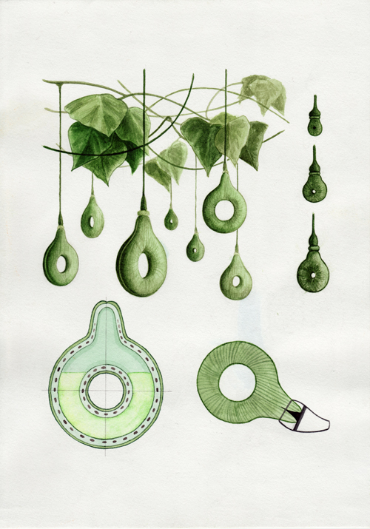
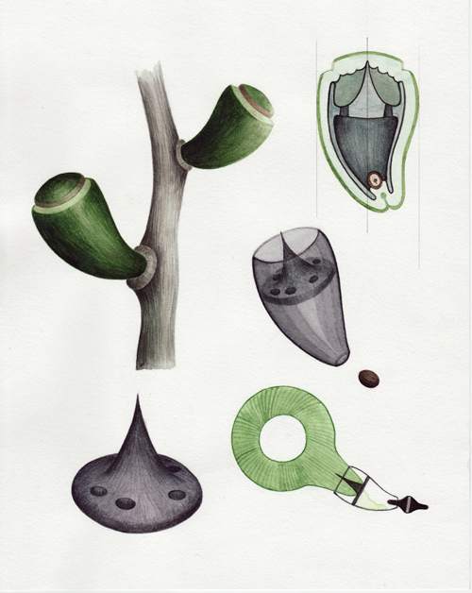
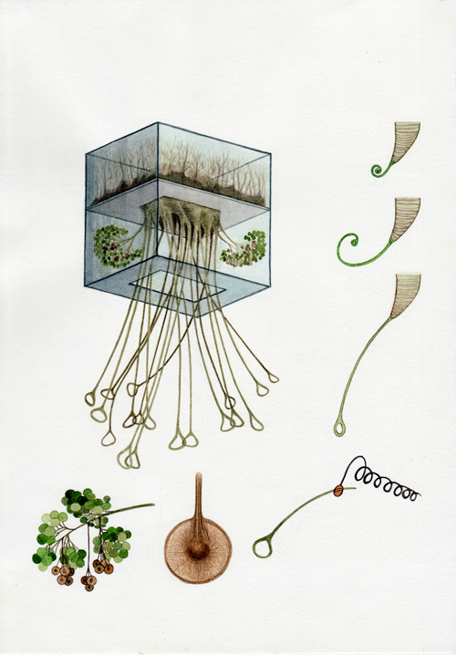
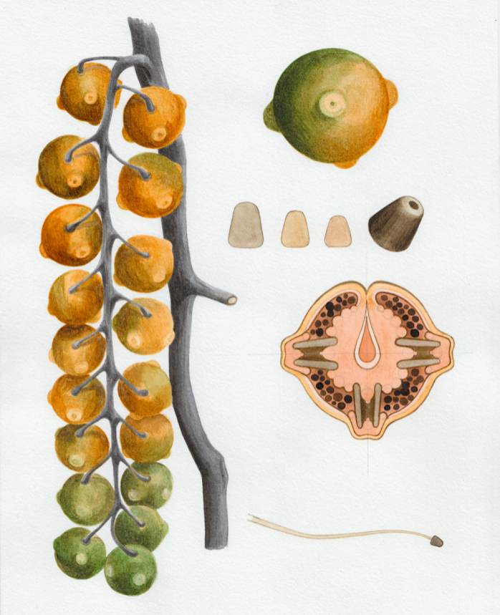
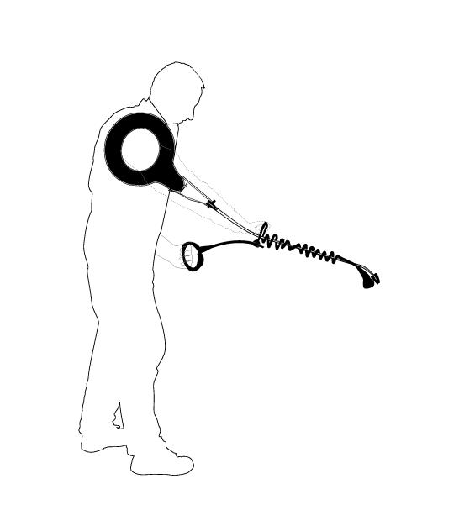
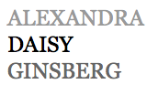
Herbicide Gourd
Connector Fruit
Handle Plant
http://www.daisyginsberg.com
From Drew Endy
Herbicide Sprayer (Nozzle Fruit)
Herbicide Sprayer, assembled
Notes:
The most obvious of these differences is the potential for multicellularity. One of the many useful qualities to multicellularity is that it enables the genetic encoding of macroscale morphology through development processes. Daisy Ginsberg is an artist who has speculated on the future of synthetic biology and the potential for encoding the biological production of complete consumer products. Here she imagines how individual components of a gardening device could be produced in engineered organisms and then assembled into an herbicide sprayer. Though such applications are beyond the current capabilities of our field, eukaryotes and developmental processes are nevertheless a popular focus of research in synthetic biology.

Slide 3
Eukaryote-only chassis properties
Plants and animals (metazoans), some aspects true of Yeast (fungi), protozoans, and archaea as well, but those organisms are their own story
Differences in cell biology
Many organelles
Actin/Microtubule cytoskeletons (in metazoans) – allows for adaptive morphological changes
G0 state
Gap junctions – allows nutrients to flow between cells in multicellular organisms
Apoptosis – cells cleanly kill themselves
Differences in molecular biology
Introns /Splicesome – coding sequences are split up into exons
Ubiquitin/degradosome
microRNAs – small regulatory RNAs
Mediator complex -- required for transcription of most class II promoters (protein-coding genes)
Capping and adenylation of mRNAs
Tyrosine kinase signaling
MAP Kinase signaling
Notes:
Principally I am speaking of plants and animals in these chapters, though organisms such as yeast, protozoa, and even archaebacteria have many of the characteristics of the multicellular organisms. They differ from prokaryotic biology at both at the cell and the molecular levels.
*
We’ll go through each of these features in some detail next, so I’ll just list them here. Eukaryotes have organelles which comparmentalize specialized processes. They have cytoskeletons made of actin and microtubulues that allow them to change their shape. They have a G0 state that allows them to remain physiologically active while not replicating. They have gap junctions that allow them to share nutrients between cells, and finally they have programmed cell death called apoptosis that allows them to remove cells from the multicellular system
*
There are also differences at the molecular level. Eukaryotes have introns and splicesomes which process mRNAs prior to translation. They have specialized degradosomes for programmatically removing proteins. They have microRNAs for epigenetic control of gene expression. They have mediator which is a more complex means of controlling transcription initiation. The mRNAs have specialized structures at their end to signal their identity instead of relying on internal sequences for initiation, and finally they have tyrosine and MAP kinase signaling cascades for dynamic environmental sensing.

Slide 4
The big picture
Basically, anything that can be done with 1 protein in a prokaryote, eukaryotes do with 10 proteins organized into a molecular machine
Hence, they have about 10x more genes (total) than prokaryotes do
They grow really slowly
From a tools perspective, much more limited than E. coli and Yeast
Mammalian cells:
Usually use transient transfection of multiple plasmid DNAs
Will integrate in the genome with low efficiently, can select for integrants, take a long time
Can efficiently integrate 1 gene per integration event using retrovirus derived virus particles, require several days to prepare particles
Plant cells:
Agrobacterium invades plants and delivers a large plasmid
Gold particle bombardment with DNAs
Notes:
One of the most salient features of eukaryotic genetics is the larger number proteins associated with familiar processes. Typically, around 10x more polypeptides are involved in a process that requires one protein in prokaryotes. Often these polypeptides self assemble into large molecular machines. Thus, they have typically around 10x more genes.
*
As a result, they necessarily grow slower than prokaryotes to have time to replicate the genome.
*
From a tools perspective, the genetics of higher eukaryotes is more limited than E. coli and Yeast genetics
*
The easiest way to install genes into mammalian cells is transient transfection. Many lines of mammalian cells update DNA just fine, and what is challenging is getting stable replication of the genes. If you just want to express the genes for a few days, such stable replication is not required. It can be challenging to control gene dosage when using this approach. Transiently transfected DNAs will randomly integrate into the genome, and such cells can be selected with chemicals, but it is a slow process. There are also viral technologies that efficiently integrate into the genome. Such processes are slow to perform, but highly efficient once the virus particles are prepared. Installing more than 1 gene into the genome with precision is still a challenging activity with eukaryotes.
*
Many plant cells are also genetically tractable. Agrobacterium is a bacterium that invades plants and delivers a large plasmid. Genetic manipulation systems derived from agrobacterium enable users to manipulate the plant genome. Some plant cells are also amenable to gold particle bombardment strategies to introduce synthetic DNAs.
Eukaryote genetic manipulation is still far more challenging from a technical perspective than prokaryotes due to the slow speed of these technologies and the slow growth rate of the cells. However, the methods of gene delivery to eukaryotes is an active and moving area of research.

Slide 5
Enabling Multicellularity
Notes:
There are specific qualities to the eukaryotic chassis that enable them to self-assemble into multicellular systems in ways not observed in prokaryotes. Sure, some bacteria will produce biofilms, fruiting bodies, and spores, but such processes do not result in the morphological control accessible with eukaryotes.

Slide 6
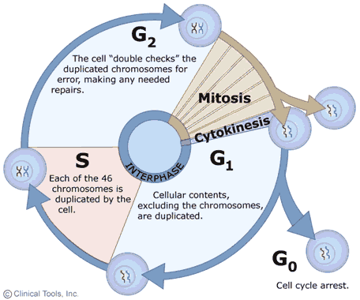
The G0 state
State | Phase | Description
quiescent/ | G₀ | A resting phase where the cell has left the cycle and has stopped dividing.
senescent
interphase | G₁ | Cells increase in size in Gap 1. TheG1 checkpoint control mechanism ensures that everything is ready forDNA synthesis.
 | S | DNA replication occurs during this phase.
 | G₂ | During the gap between DNA synthesis and mitosis, the cell will continue to grow. The G2 checkpointcontrol mechanism ensures that everything is ready to enter the M (mitosis) phase and divide.
cell division | M | mitosis, where the cell actually splits in two
Non-differentiated cells and some other cells like B cells are replication-competent and cycle through G1, S, G2, and M states
Most differentiated cells are permanently locked in the G0 state
They can do translation and transcription, and remain fully active biochemically, just don’t divide
No comparable state exists in prokaryotes, closest thing is “stringent response”
Notes:
First is the G0 state. There are distinct phases to a eukaryotes replication cycle, and you are probably already familiar with G1, S, G2 and M states. In the G0 state, the cells entering a resting phase where they remain physiologically active, but the cells are not replicating their DNA or dividing. Non-differentiated cells and some other cells like B cells are replication-competent and cycle through G1, S, G2, and M states. However, Most differentiated cells are permanently locked in the G0 state. They can do translation and transcription, and remain fully active biochemically, just don’t divide. No comparable state exists in prokaryotes, but the closest thing is “stringent response”. Here, bacteria slow all central dogma processes. It is very challenging to have a physiologically active prokaryote that is not actively undergoing replication.

Slide 7
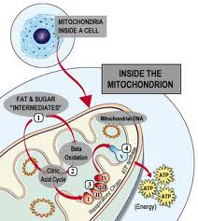
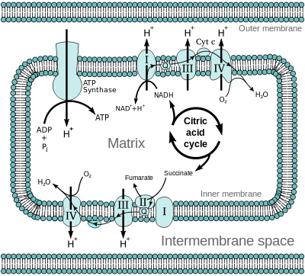
Cellular specialization (ex. Mitochondria)
The cellular membrane is freed from other obligations by diversion of those processes to specialized organelles
Notes:
The organelles of a eukaryote enable them to spatially localize specific processes that might interfere. For example, processes like respiration that occur in the inner membrane in prokaryotes are localized to specialized mitochondria in a eukaryote. This frees up the celular membrane from obligations in central processes by diversion of those processes to specialized organelles. This allows the cell to use its cell membrane for other purposes.

Slide 8
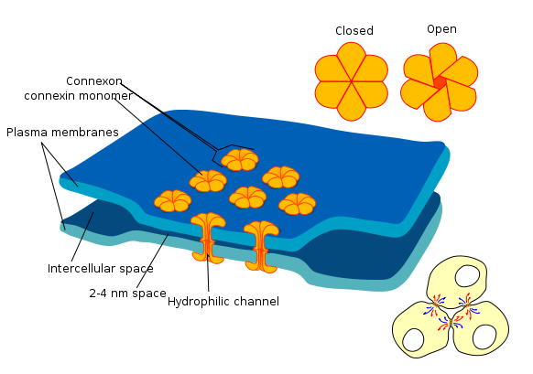
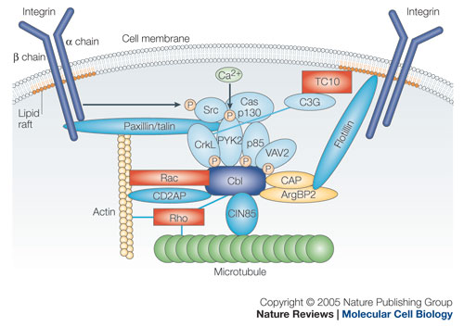
Cell attachments
Gap junctions: 2 nm tubes linking the cytoplasms of two cells, allow flow of metabolites up to 1000 daltons (about 10 aa peptides)
Adherens Junctions: made of cadherins and catenins, hold epithelial cells together
Tight Junctions: define apical and basolateral sides of epithelial cells and close off exposure of internal cavities
Integrins: surface-displayed proteins that bind to extracellular matrix, also enable transduction of binding via focal adhesions
Notes:
There is also collaboration between cells. Sealed junctions between two cells called gap junctions allow the free exchange of metabolites between two cells. Additional surface-presented features such as adherens, tight junctions, and integrins enable intimate interactions between cells that stabilize multicellular structure.

Slide 9
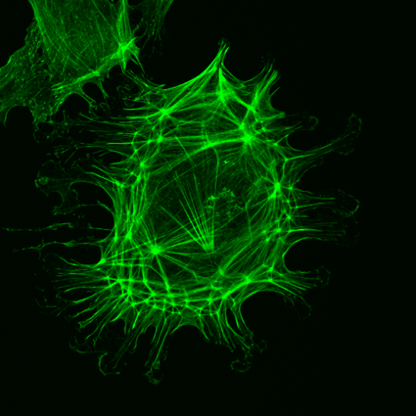
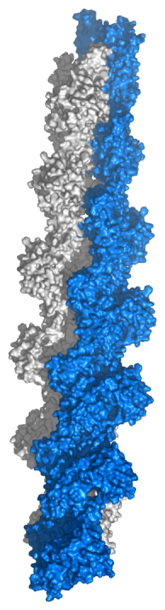
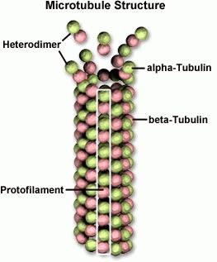
The cytoskeleton
Actin and microtubules maintain and determine cell shape from inside
Allows the cell to dynamically change its shape
Also used for movement via lamellipodia and filopodia
Bacterial and yeast shape is restricted by the cell wall
Notes:
Finally, they have a cytoskeleton composed of protein polymers. Like the struts supporting the roof of a circus tent, Actin and microtubules maintain and determine cell shape from inside eukarotic cells. This allows the cells to dynamically change their shapes. It also enables specialized locomotion mechanisms using lamellipodia and filopodia

Slide 10
The cytoskeleton
http://www.youtube.com/watch?v=7b5y9cW-pd8
Notes:
In this video, you are watching a cell moving through the modification of its actin cytoskeleton
Bacterial and yeast shape is determined by a rigid cell wall and they have no mechanisms for dynamically altering their shapes. This limits these organisms to simple multicellular morphologies.

Slide 11
Eukaryotic Gene Structure
Notes:
If we wish to construct synthetic genes and modify eukaryotes. The first think to be aware of is that the details of transcription and translation aren’t quite the same as in prokaryotes. A eukayotic gene doesn’t look like a prokaryotic one.

Slide 12
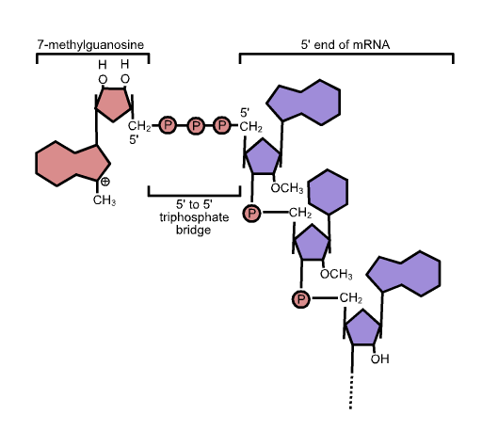
Transcription in Eukaryotes
Have 3 distinct transcription process:
RNA Polymerase I Larger ribosomal RNA (rRNA)
RNA Polymerase II messenger RNA (mRNA) and most small nuclear RNAs (snRNAs)
RNA Polymerase III transfer RNA (tRNA) and other small RNAs
mRNA transcription requires the mediator complex
mRNAs encode a single polypeptide
mRNAs have a poly A tail
mRNAs have a 5’ cap required for translation, export, avoiding degradation
Notes:
Transcription has some important differences. First, there are 3 distinct transcription processes containing distinct polymerases for distinct types of RNAs. The polymerase that makes the tRNAs is not the same complex as the one that makes the mRNA or the rRNA. There are three distinct promoter architectures. We’ll only worry about the ones that generate mRNAs in these lectures to keep it simple.
transcription requires the mediator complex which we’ll address next
mRNAs encode a single polypeptide instead of multi-gene operons
They have a poly A tail on their 3’ end
And finally mRNAs have a 5’ cap required for translation, export, avoiding degradation

Slide 13
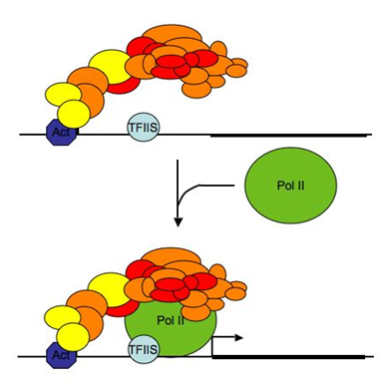
Mediator Complex For a review see PMID: 15896740
Regulation in prokaryotes is relatively simple
Regulation of protein-coding genes in eukaryotes has an additional layer of control by Mediator complex that binds to activators
Contains about 20 subunits, over 1 million daltons
Has a kinase sub-complex
It is a complicated molecular machine like many eukaryotic processes
The overall effect of it is:
There is no such thing as a constitutive promoter in eukaryotes, there is always some activator
How operator sites influence each other is less intuitive
Off is really off in eukaryotes
Activators merely recruit, less geometrically constrained, allows them to be more modular—have distinct activation and DBD domains, don’t have to be dimers
Notes:
Regulation in prokaryotes is believed to be relatively simple. There is the sigma70, and if it binds transcription occurs. If it doesn’t bind, nothing else happens.
In eukaryotes there is an additional layer of control by Mediator complex that binds to activators and recruits the polymerase. It s this orange cluster in the diagram. In some ways you can think of Mediator as being like sigma70 in prokaryotes, but it
contains about 20 subunits, and over 1 million daltons, so it’s a more complicated beast. It contains an internal regulatory processes called
the kinase sub-complex
Not much known about how it works, it’s a complicated molecular machine like many eukaryotic processes
But the overall effect of it is:
There is no such thing as a constitutive promoter in eukaryotes, there is always some activator. Mediator doesn’t directly bind to the DNA.
How operator sites influence each other is less intuitive. All the same mechanisms (looping, competition) are still at play, but often these operate over a long distance that cannot be explained based on simple biophysical ideas.
One useful artifact of this is that OFF is really OFF in eukaryotes. It is often easier to express really toxic genes in eukayotes than prokarytes where leaky transcription is the norm.
The Activators merely recruit mediator. Transcription initiation is more of an active process than a spontaneous one, and geometry of the interactions is less constrained. This allows eukaryotic transcription factors to be more modular and diverse. They typically have distinct activation and DBD domains, and they don’t have to be dimers

Slide 14
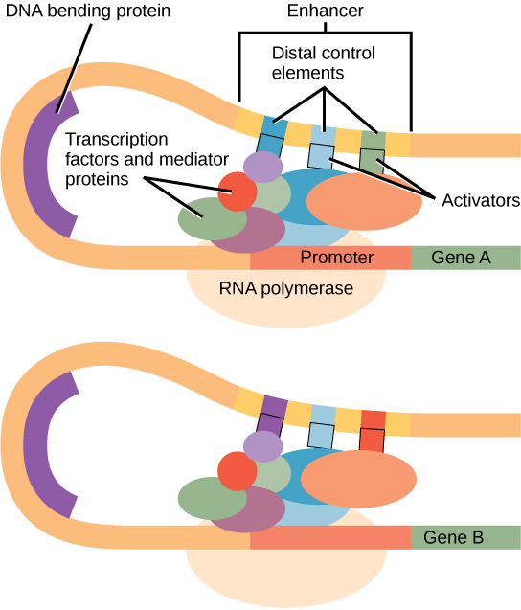
Other novelties in transcription
In addition to activators, get “enhancers” that bind operators sometimes many kb from the site of transcription initiation
Notes:
There are additional aspects of eukaryotic transcription that aren’t exactly unique to them, but are far more prevalent phenomen.
In addition to activators, there are “enhancers” that bind operators sometimes many kb from the site of transcription initiation.

Slide 15
Other novelties in transcription
In addition to activators, get “enhancers” that bind operators sometimes many kb from the site of transcription initiation
Eukaryotic DNA is organized into a higher-order structure through the action of histones
Position of histones relative to a promoter affects expression
Methylation and acetylation of the histones also influences them, and is a primary mode of controlling gene expression
Also get direct methylation of the DNA; CpG methylation in metazoans present in ~75% of CG sites, occur in little islands, repress transcription
miRNAs play a major role in regulating pre-mRNAs post-transcriptionally
Notes:
Eukaryotic DNA is organized into a higher-order structure through the action of histones
The positions of these histones relative to a promoter affects expression
Methylation and acetylation of the histones also influences them, and is a primary mode of controlling gene expression
There is also direct methylation of the DNA. In animals (or more specifically metazoans) CpG methylation is present in 75% of CG sites. The typically occur in clustered regions of the genome, and they repress transcription. DNA methylation is also very common in prokaryotes, but it rarely plays the same sort of regulatory role as it does in eukaryotes.
Though not all eukaryotes or even all animals have miRNA, higher ones have them and they play a major role in regulating pre-mRNAs post-transcriptionally

Slide 16
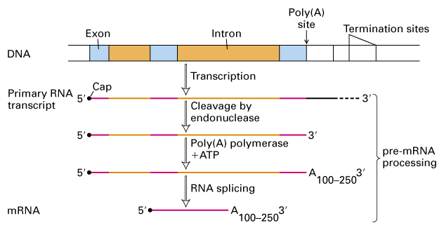
Introns and the spliceosome
In some eukaryotes, the introns must be present to get expression
Get alternate splice variants from one gene, so one gene can encode multiple variants of one protein, is a target for regulatory mechanisms
Notes:
Once an mRNA is generated, it often undergoes splicing which removes regions of the sequence called introns to join together fragments of the protein. Often the exons encode domains of a protein, and this separation of distinct domains enables modular recombination in such organisms. In some eukaryotes, the introns are necessary for expression. Synthetic genes that lack introns will not express as well. One gene can also give rise to multiple splice variants. Thus one gene can encode multiple variants of a protein that may include some domains and not others. This splicing is also sometimes a target of regulation.

Slide 17
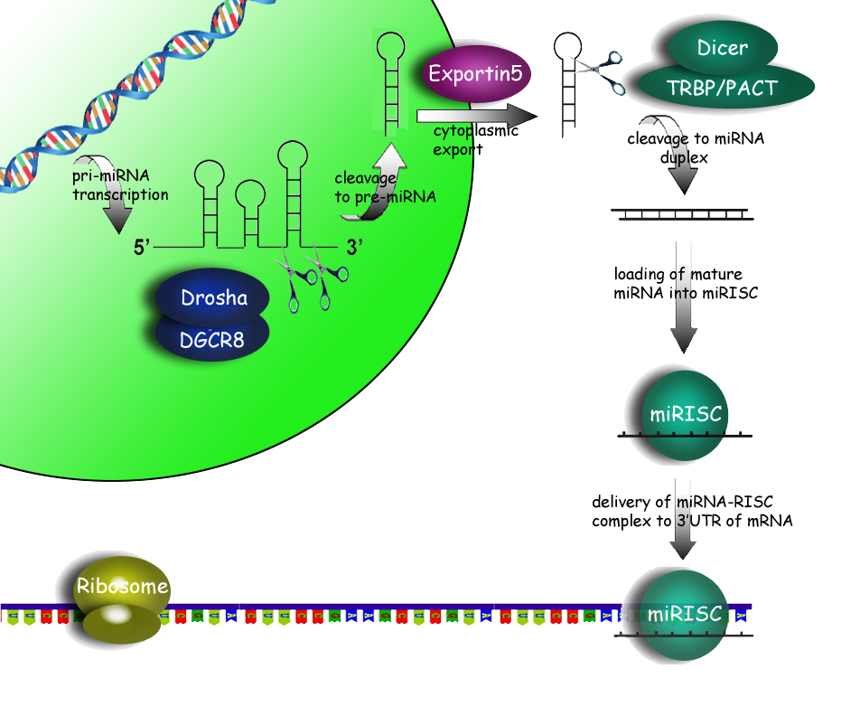
miRNA
Notes:
Mechanistically, a miRNA-coding gene in the genome undergoes transcription resulting in a pri-miRNA transcript. This RNA is processed by Drosha in the nucleus and then exported to the cytoplasm. Here, Dicer performs additional cleavage to generate the miRNA as a linear doublestranded molecule. The mRNA is then loaded onto RISC complexes which then guides the cleavage of homologous sequences.

Slide 18
miRNA
“microRNAs” have emerged as major components of transcriptional control in recent years
siRNA is the engineered variation of this, but the mechanism happens from endogenously-encoded RNAs
See PMID: 19606257 for a good review of how they get made
Usually are 21-23 nucleotides in length
Sequence is complementary to an mRNA and causes degradation or influence splicing
Get other variations of miRNA: RNAa activate transcription initiation, piRNA are 26-31 nucleotides in length, encoded by clusters in the genome, silence selfish-elements in genome (retrotransposons)
Notes:
“microRNAs” have been recognized as major components of transcriptional control in recent years
siRNA is the engineered variation of this, but the mechanism happens from genomically-encoded RNAs as well
Usually these RNAs are 21-23 nucleotides in length, and their sequence is complementary to an mRNA and causes degradation or influence splicing
There are other types of micro RNAs that play other regulatory roles. RNAa’s are ones that activate transcription initiation. piRNA are 26-31 nucleotides in length and encoded by clusters in the genome. They silence selfish-elements in genome (retrotransposons)

Slide 19
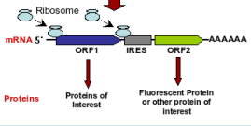
Translation in Eukaryotes
Translation is relatively simple
Get one polypeptide from each mRNA, no operons
Translation occurs in the cytoplasm.
Ribosome looks for the first ATG on 5’ capped RNAs
Don’t get the same high influence of the ribosome binding site as you do in prokaryotes
Can have “Internal ribosome entry sites” (IRES) elements that allow multiple polypeptides on one mRNA
IRES are frequently used in bicistronic reporters with GFP
Eukaryotic proteins, particularly extracellular ones, can be much larger than prokaryotic ones, have additional chaperone machinery
Notes:
The presence of a 5’ CAP on an mRNA makes translation in eukayotes relatively simple. The machinery uses this cap to identify the molecule and initiation translation. Thus it does not have to survey the sequence for specific sequences.
Additionally, eukaryote genes encode one polypeptide from each mRNA, they do not have operons
The mRNA is transcribed and spliced before export from the nucleus. Translation occurs in the cytoplasm.
Ribosome looks for the first ATG on 5’ capped RNAs
Thus there is not the same high influence of the ribosome binding site and its conformation due to sequence context like there is in in prokaryotes
Sometimes the lack of operons is a limitation for engineering. One solution is to encode “Internal ribosome entry sites” (IRES) elements that allow multiple polypeptides on one mRNA
IRES are frequently used in bicistronic reporters with GFP such that you can confirm the expression of the first operon by monitoring the phenotype caused by the second operon, which is usually an FP or an antibiotic resistance gene.

Slide 20
Sensing and Transduction
Notes:
We’ve discussed how prokaryotes sense their environment using transcription factors and chemotaxis sensory proteins. Eukaryotes similar have sensor proteins that link environmental events to changes in transcription or other mechanisms of regulation. However, they employ evolutionarily unrelated proteins to do so that have different biochemical mechanisms.

Slide 21
The big picture
More happens at the post-translation level in eukaryotes than in prokaryotes
In prokaryotes, the integration of information tends to occur at the level of transcription initiation on complex promoters, transduced by signal-specific sensing apparatis
In eukaryotes, the decision making happens through crosstalk of protein/protein interactions often via phosphorylation changes
Signal transduction gets extremely complicated, understanding it a the primary focus of systems biology
Notes:
* In the big picture, more happens at the post-translational level in eukaryotes than in prokaryotes
* In prokaryotes, the integration of information tends to occur at the level of transcription initiation on complex promoters, transduced by signal-specific sensory proteins and transcription factors
*In eukaryotes, the decision making happens through crosstalk of protein/protein interactions often via phosphorylation changes
*Eukaryotic Signal transduction gets extremely complicated, understanding it a the primary focus of systems biology

Slide 22
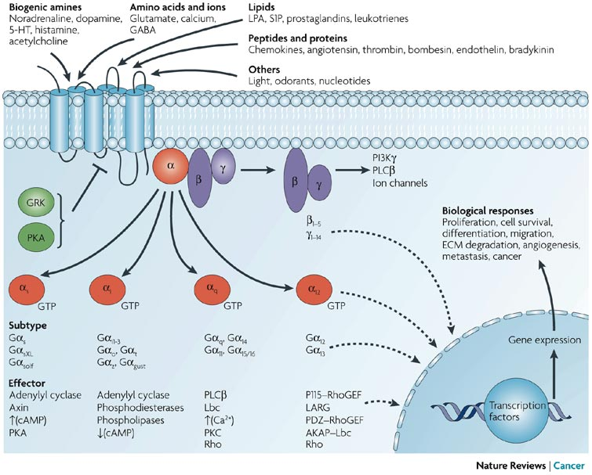
G proteins and GPCRs
Notes:
Here you are looking at G protein signalling in a GPCR system. The GPCR itself is a multi-pass integral membrane protein. It has ligand binding sites. When they bind their ligand, they activate a heterotrimeric G protein by release of its alpha subunit. These alpha subunits can go on to do all sorts of things in the cell. Sometimes they directly affect the activity of other proteins in the cell, while other alpha subunits enter the nucleus and alter gene expression.

Slide 23
G proteins and GPCRs
One major signal transduction route is the use of G-protein coupled receptors (GPCR)
Used for things like smell
The ligands for most GPCRs are unknown, but there are many of them
G proteins bind and hydrolyze GTP upon activation
Heterotrimeric G proteins are made up of alpha (α), beta (β), and gamma (γ) subunits and are the ones that work with GPCRs
Small Ras-superfamily GTPases are single subunit, they are the ones that show up in the tyrosine kinase/MAPK pathways
Guanine nucleotide exchange factors (GEF) echange out GDP reloading GTP, is a distinct protein for the Ras-type
The GPCR is the GEF for the heterotrimeric type, is the mode of communicating receptor activation, results in dissociation of alpha subunit
The alpha subunit eventually hydrolyzes the GDP and returns to the βγ complex
GTPase-activating proteins (GAP) can deactivate G proteins by inducing hydrolysis of the GTP
Notes:
When talking about transcriptional control in prokaryotes, we spoke of things like two component histidine kinases and pleiotropic transcription factors. In eukayotes, there similarly are these repeated patterns of signal transduction that employ homologous proteins to detect and transduce disparate external signals.
One major signal transduction route is the use of G-protein coupled receptors (GPCR) which are embedded in the cell membrane. They directly respond to external signals and transduce binding by hydrolyzing a bound GTP
They are most popularly known for their role in olafaction, but they are involved in many sensory processes
The ligands for most GPCRs are unknown, but there are many of them, and GPCRs are often drug targets in pharmaceutic discovery
Biochemically, the G proteins bind and hydrolyze GTP upon activation. There are two types of G proteins:
Heterotrimeric G proteins are made up of alpha (α), beta (β), and gamma (γ) subunits and are the ones that work with GPCRs
Small Ras-superfamily GTPases are single subunit, they are the ones that show up in the tyrosine kinase/MAPK pathways
For the RAS-type G proteins, Guanine nucleotide exchange factors (GEFs) will exchange out GDP for a new GTP molecule
For the heterotrimeric type G proteins, the GPCR is the GEF. the mode of communicating receptor activation, results in dissociation of alpha subunit
The alpha subunit eventually hydrolyzes the GDP and returns to the βγ complex
Additionally there are things called GTPase-activating proteins (or GAPs) that can deactivate G proteins by inducing hydrolysis of the GTP

Slide 24
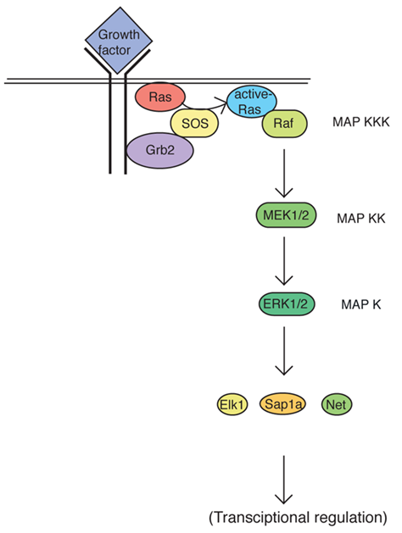
Signal Transduction
Eukaryotes use serine/threonine/tyrosine kinases, more elaborate relays
The tyrosine kinase receptor → G protein → MAP (serine/threonine ) kinase cascade → transcription regulation is a very common motif
MAPK is not a specific protein, it’s a family of proteins
Some specifically named MAPK’s are also classes of proteins
Many of them operate in a single cell
There is extensive cross-talk between them
They are often described in papers as a class without distinguishing specific kinases
Notes:
The other major class of signal transduction cascades are the map kinase cascades that typically iniate from signals of a tyrosine kinase. Like the GPCRs, the tyrosine kinases are embedded in the cell membrane and are stimulated by external signals. In response, they phosphorylate tyrosine residues on proteins. Often this signal is transduced through the Ras-style G proteins and relayed onto a MAP kinase cascade. Here, a relay of kinases transduces the signal through phosphorylation of threonine or serine residues on other signalling proteins ultimately activating transcription factors.
*
One thing to be aware of in reading literature about these proteins is that MAP kinase is not one specific protein. It refers to a homologous class of proteins that are functionally related, but play disparate roles in the cell.
*
Some specifically named MAPK proteins, such as Erk are themselves also classes of proteins that may be encoded by multiple genes in the genome in addition to multiple splice variants.
*
It is typical to have many such kinases all in one cell type
*
And there is extensive cross talk between them
*
Due to the non-specific nature of the tools used to study them, MAPK activity is often described in terms of protein class without knowing exactly which ones do the reactions.

Slide 25
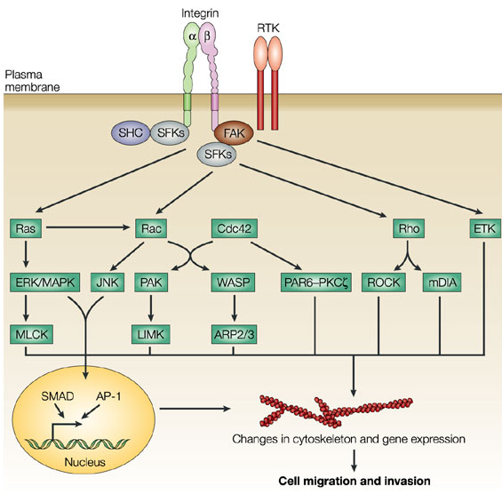
Focal Adhesion Tyrosine Kinase (FAK)
Notes:
Here is an example. The focal adhesion tyrosine kinase is associated with the cytoskeleton and to anchoring proteins such as integrins. These proteins attach the cell with the extracellular matrix or to other cells. FAK senses changes the cell’s association with an external physical support. Signalling is transduced to the G proteins Ras and Rho which interact with other G proteins including CDC42. These G proteins further stimulate several MAP kinase cascades, some of which result in changes in gene expression while others directly affect the structure of the cytoskeleton.

Slide 26
Apoptosis
Many signal transduction cascades are coupled to the apoptosis machinery
Not under transcriptional control, is all phosphorylation and proteolytic cleavage mechanisms
Major players are the caspases, which are cysteine proteases
There are at least 11 capases in humans, there is a cascade of activation where they activate each other by cleaving them
Mitochondria play a major role as well, releasing cytochrome C to the cytoplasm is a major event inducing apoptosis
Basically everything in the cell gets efficiently torn up at the end of it including DNA fragmentation, breakdown of the nucleus, inactivation of DNA repair enzymes
Cell is eventually reduced to multiple vacuoles that get consumed by macrophages (in animals)
Very important in development, such as dividing your fingers from one another
Important in the immune system too, things like killing off self-reactive antibody-producing B cells
Plants do it too
Notes:
Many signal transduction cascades are coupled to the apoptosis machinery
The proteins associated with apoptosis are not under dynamic transcriptional control. The events that trigger this system are all posttranslational reactions involving phosphorylation and proteolytic cleavage mechanisms
The major players are the caspases, which are cysteine proteases
There are at least 11 capases in humans, there is a cascade of activation where they activate each other by cleaving them
Mitochondria play a major role as well. The release of cytochrome C to the cytoplasm is a major commitment step during apoptosis
As a result of apoptosis, everything in the cell gets efficiently degraded including DNA fragmentation, breakdown of the nucleus, and inactivation of DNA repair enzymes
The Cell is eventually reduced to multiple vacuoles that get consumed by macrophages (in animals)
Apoptosis is very important in development, such as the dividing of your fingers from one another
They are important in the immune system too. Apoptosis is involved in processes such as elminating self-reactive antibody-producing B cells
Apoptosis isn’t just for animals, plants do it too

Slide 27
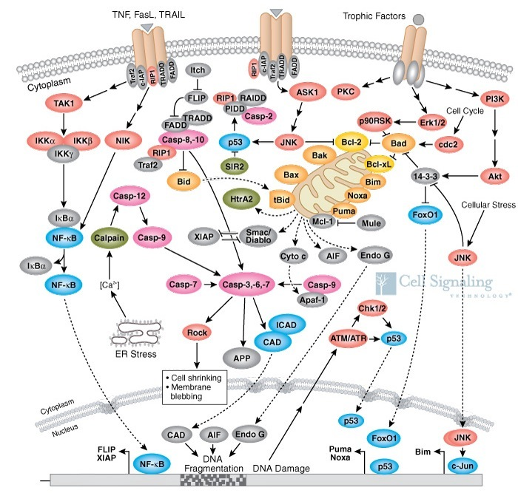
Apoptosis
Notes:
But keep in mind it is a very complicated process that is tied into many signal transduction cascades. The details of this diagram aren’t important for our purposes of discussion, but do not be fooled into thinking that it is simple.

